Slide 1
Students grievance redressal system
Page: 1
Presented by
Arun Prasad M
Aravind S Menon
Aswin Animon
Fivil Mary
Guide Name: Assist.Prof. Sebin Jose

Slide 2
Problem definition
Page: 2
Manually, the students go directly to the concerned authority to address their grievances. The disadvantage is that authorities might forget about it and the grievance resolution might get delayed. Thus making this rather unreliable.
The grievance submitted by the students might not be secure and confidential as others might be able to know about it.
But by using the Students Grievance Redressal System, the students will be able to submit their grievances about their concerns from anywhere.
Authority will be able to see students complaints and review them and do the necessary to resolve them accordingly. If they think the complaint needs attention from a higher authority then they can forward it to them for resolution. After taking care of the complaint, they will send an acknowledgment message to the student informing them about it.

Slide 3
relevance
Page: 3
This system provides a helping hand to students by acknowledging and solving their problems and by maintaining a healthy environment.
A student can express his/her grievance verbally but there is a chance that the concerned authority could forget about them. But here we systematically manage each grievance and give out an alert if the concerned authority didn’t make any decision to resolve it.
Since it is online, students are more willing to express their concerns more freely.

Slide 4
Existing system
Page: 4: 2

Slide 5
Submitting complaints manually
Page: 5
Here grievances are submitted completely in a manual way since sending grievances from the lower level to the critical level requires a manual process.
For submitting a grievance one should visit the related department and register their grievance in the respective grievance register, which is monitored by the respective Department head.
Or, one should visit the respective authority and convey their grievance personally.

Slide 6
DISADVANTAGES OF EXISTING SYSTEM
Page: 6
Manual process.
This system is very obsolete and not reliable.
There is no privacy in this system if a student files any complaint as anyone can know that.
This system requires a huge amount of time to resolve the query and also there is no guarantee to be solved.
Because this process is unreliable and takes much time, many students never file any complaints about their concerns.

Slide 7
Other grievance redressal systems
Page: 7
There are indeed similar systems available but the problem with those is that they have more modules and using those is rather difficult.
And those systems are made for a bigger audience and there has yet to an active grievance redressal system exclusive for students.

Slide 8
ADVANTAGES OF PROPOSED SYSTEM
Page: 8
The idea is to automate the entire complaint process.
Sending grievances from lower level to critical level is done automatically.
This system is user-friendly and provides resolution within the stipulated time.
Students are more willing to come forward and express their concerns.
The proposed system is planned to reduce its complexity and which we could implement effectively in a college like AISAT with few departments.

Slide 9
Product functions
Page: 9
This project aims to develop a safe place for students to raise their concerns and grievances without fear.
The Students Grievance Redressal system has many functions in each of its modules:
Registration is used to create an account for the user.
Login is done to direct the user to their respective homepage.
Complaint registration is done so that any registered user can submit their complaint accordingly.
The authority can send an acknowledgment message to the student if his/her grievance is taken care of.
Grievances could be forwarded to higher authorities if they think it is necessary.

Slide 10
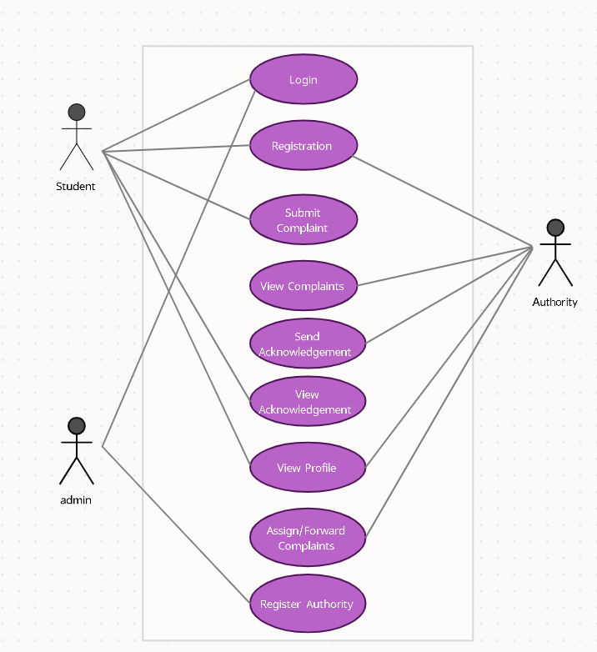
System architecture design
Page: 10

Slide 11
FUTURE SCOPE
Page: 11
The system is open to future enhancements and extensions.
Facility to upload pictures that could back up the concerned complaint.
With sufficient enhancement we can implement this system not just for the students but for the whole college.
We can also expand this system to other fields as well.

Slide 12
references
Page: 12
https://instanteduhelp.com/complaint-management-system-for-final-year/
https://ukdiss.com/examples/public-grievance-redressal-system-application.php
https://www.irjet.net/archives/V6/i3/IRJET-V6I3589.pdf

Slide 13
hardware requirements
Page: 13
This project doesn’t need any special hardware support other than the trivial hardware supports needed by all websites.
Like keyboard and mouse to navigate and interact with the page as well as monitor to view the page for visual interaction with the user.

Slide 14
SOFTWARE REQUIREMENTS
Page: 14
A web browser is necessary to access the website.
Visual Studio Code was used for website development.
MySQL database for data storage.
Python scripting langauge along with Django framework for handling the backend of the page.

Slide 15
FEATURES
Page: 15
Admin
They can add new Authorities figures to the database.
They are also able to add new departments if necessary.
Student
They can register their grievances to the authority figures.
They can also see the acknowledgment message sent by the authority figure after considering their grievances.
They are also able to see their profiles.

Slide 16
FEATURES
Page: 16
Authority
They are able to see the grievances sent by the students.
And they can also send an acknowledgment back to the student after resolving their grievances.
If they think that a particular grievance is of value and needs attention from higher authority then they can forward it to them.
They are also able to see their profiles.

Slide 17
SCREENSHOTS OF
Page: 17
OUR WEBSITE

Slide 18
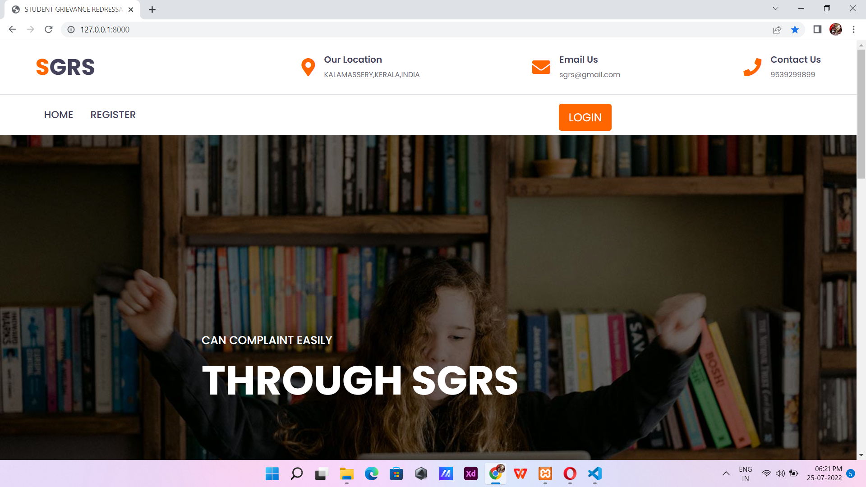
Page: 18

Slide 19
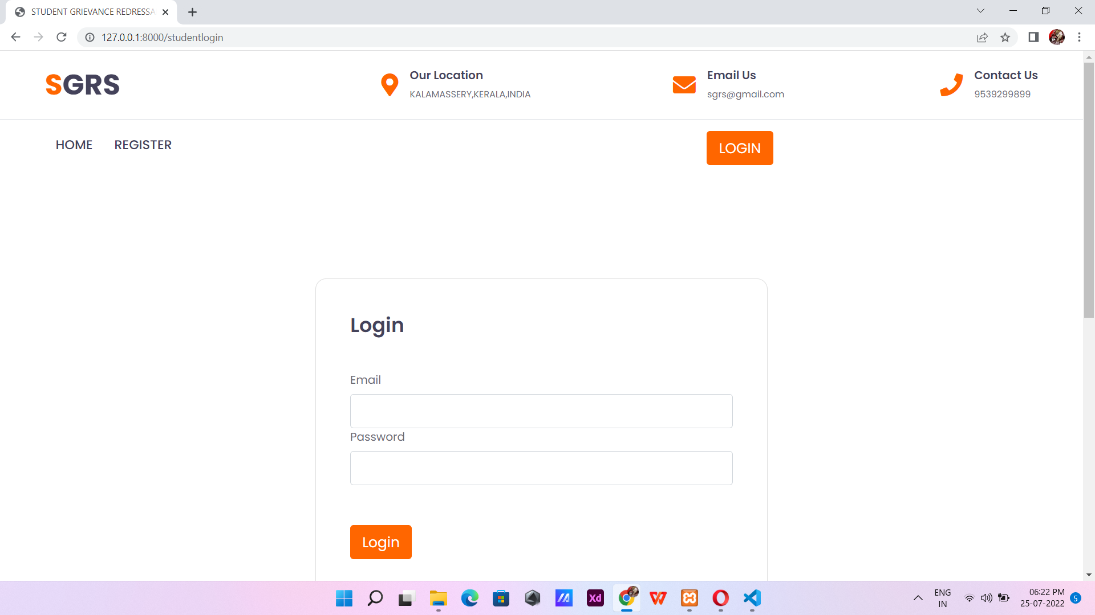
Page: 19

Slide 20
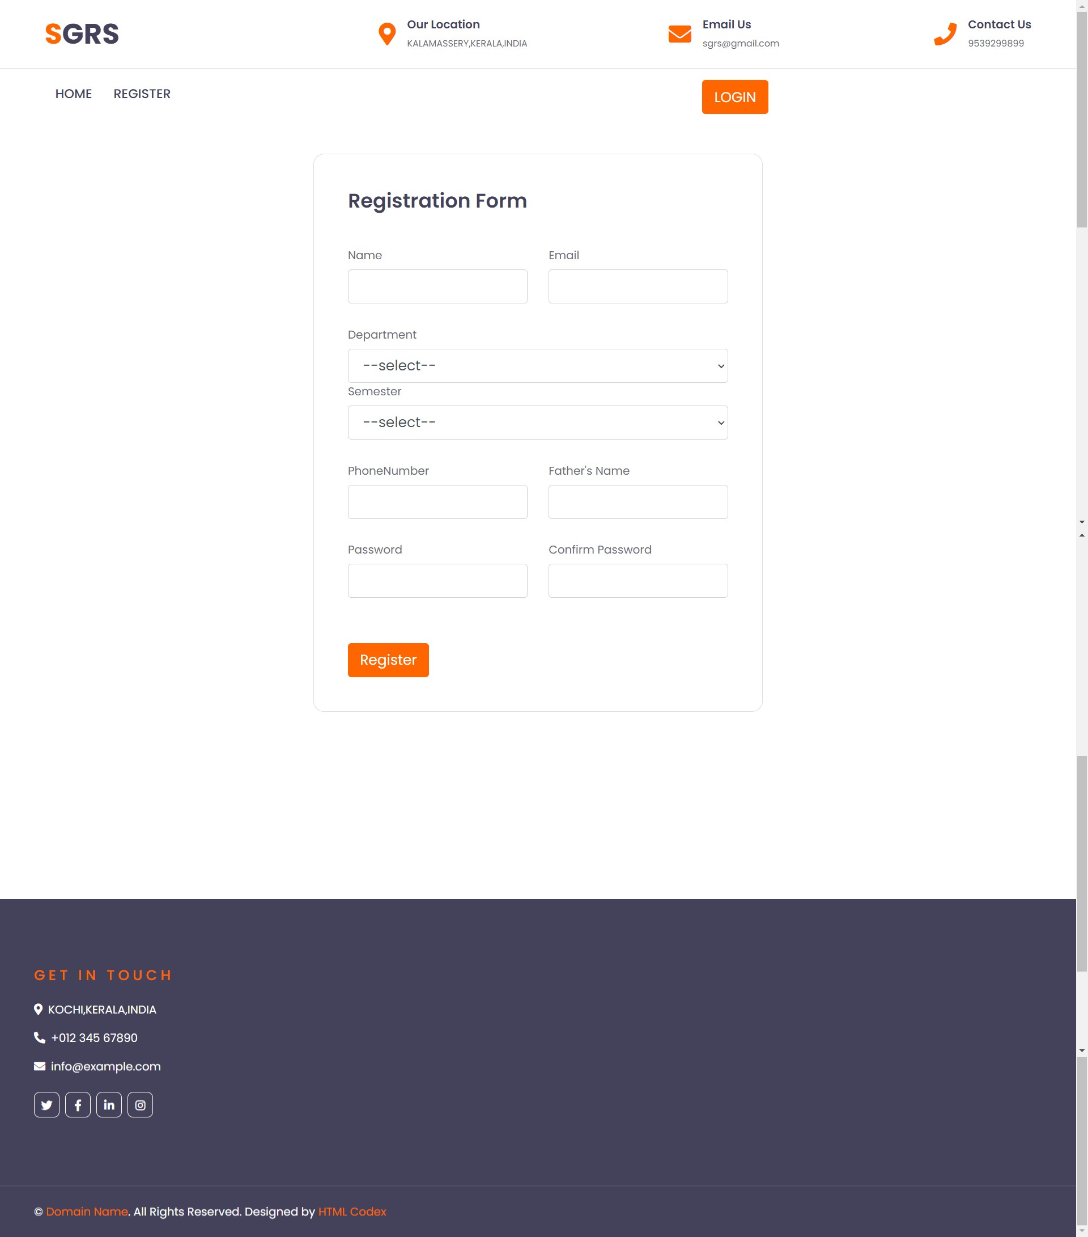
Page: 20

Slide 21
ADMIN
Page: 12
Page: 21

Slide 22
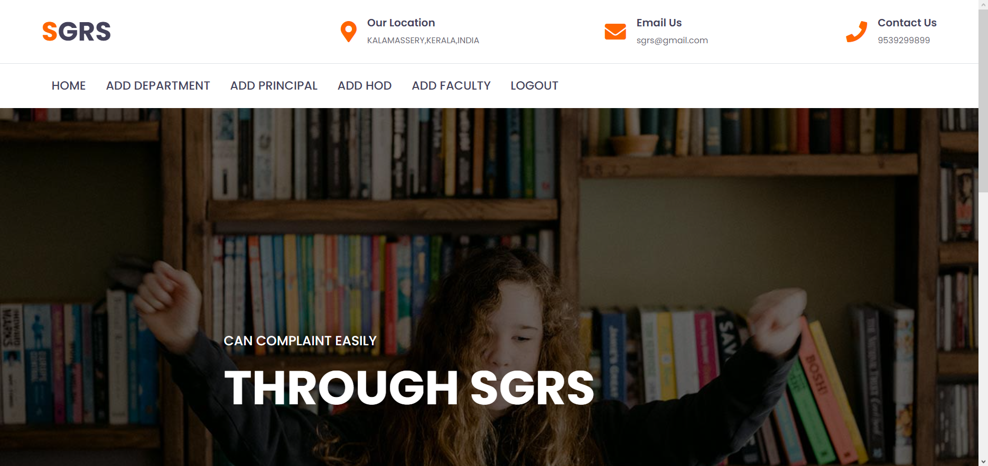
Page: 22

Slide 23
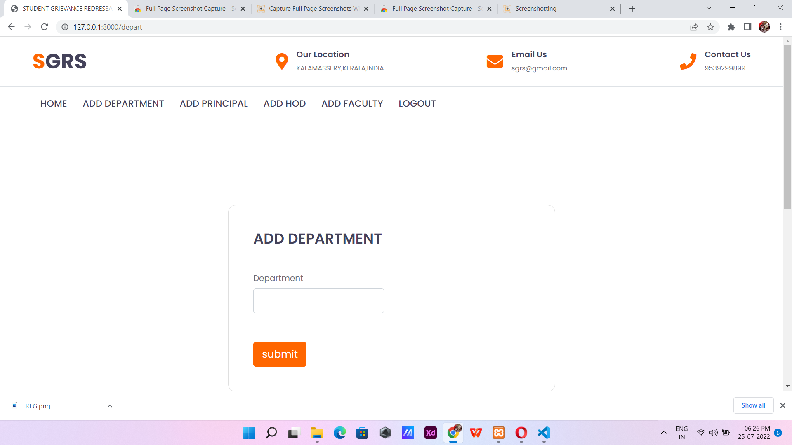
Page: 23

Slide 24
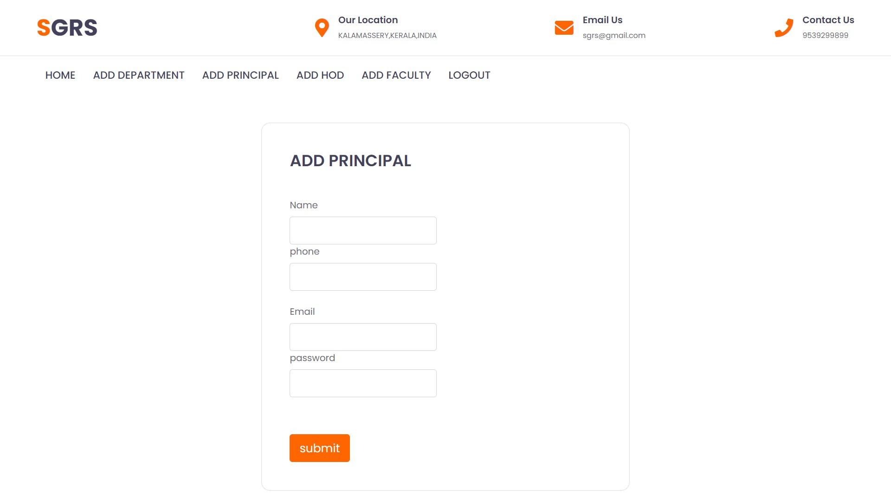
Page: 24

Slide 25
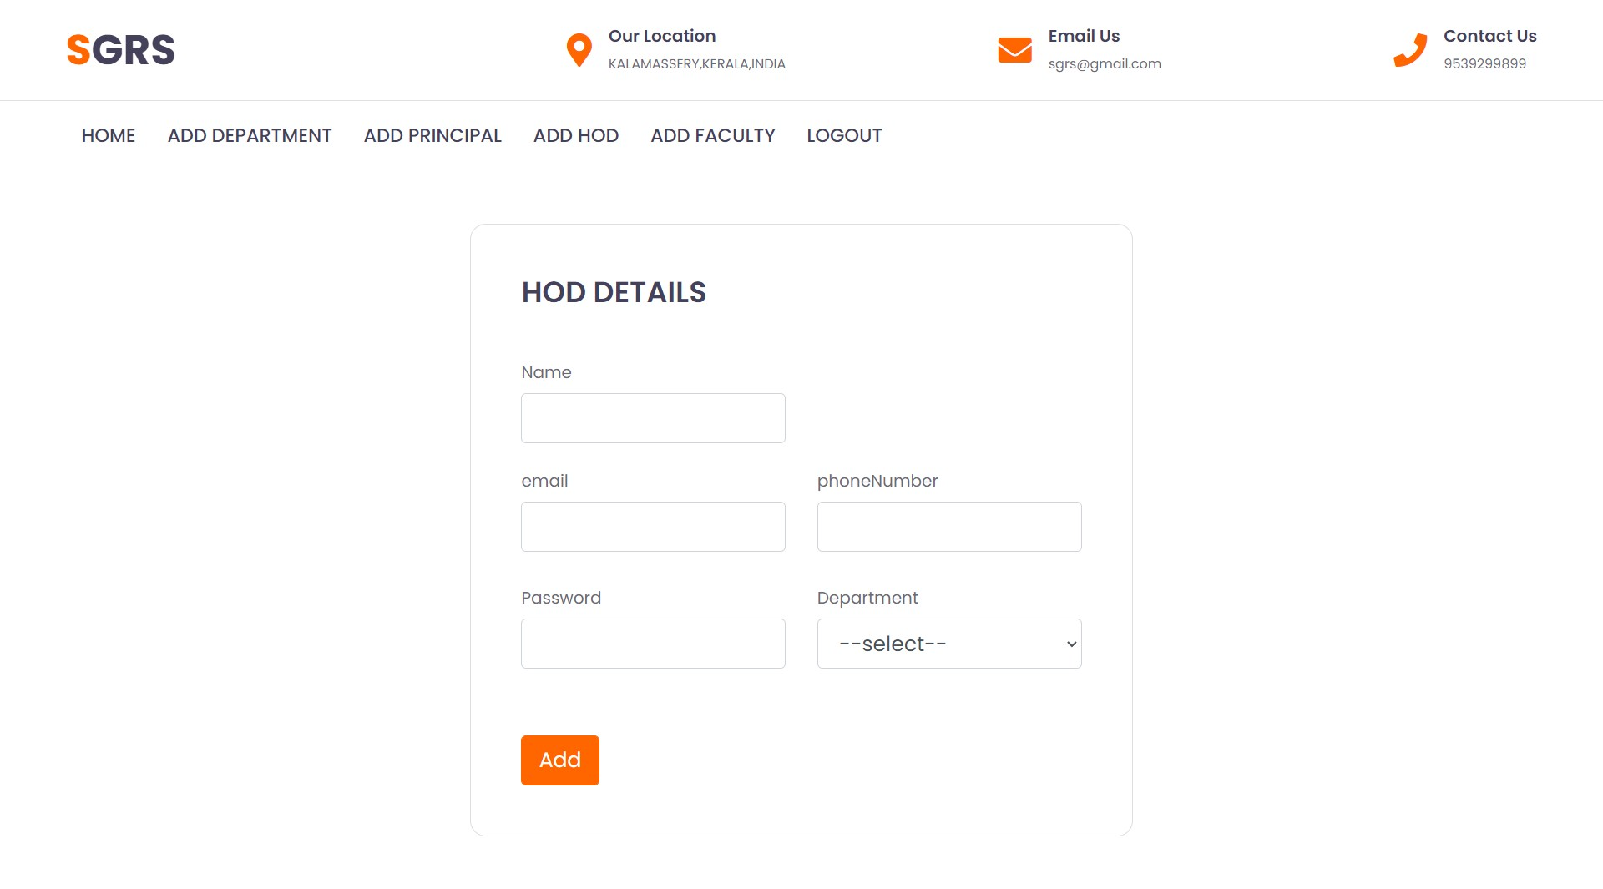
Page: 25

Slide 26
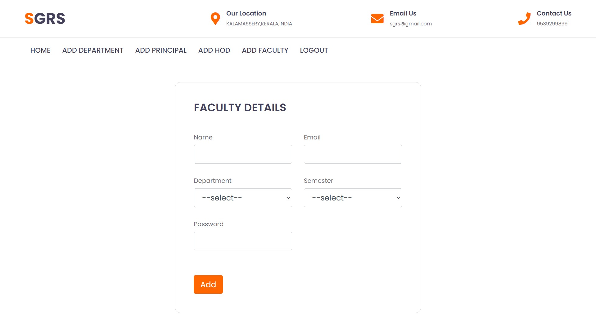
Page: 26

Slide 27
STUDENT
Page: 27

Slide 28

Page: 28

Slide 29
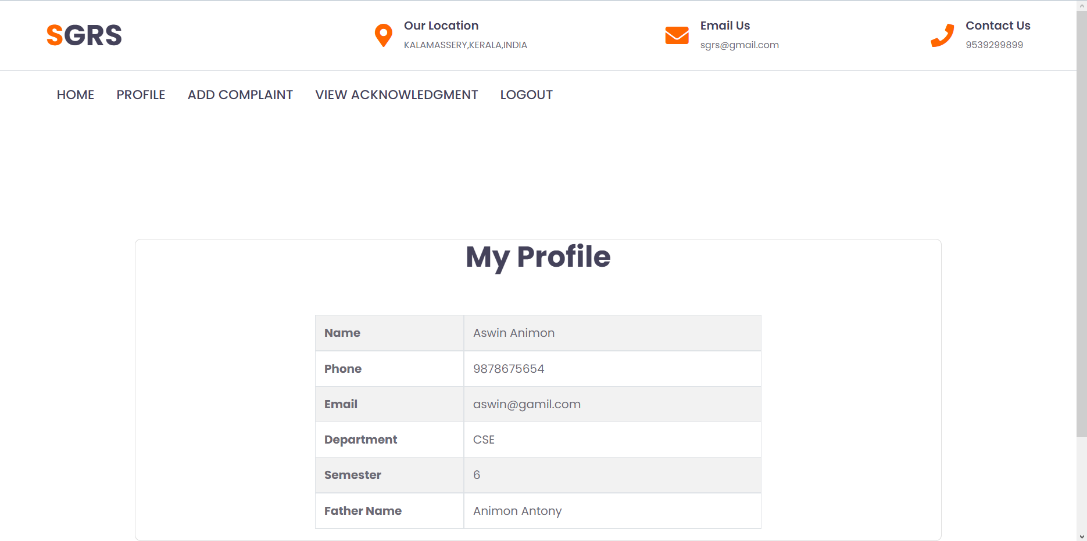
Page: 29

Slide 30
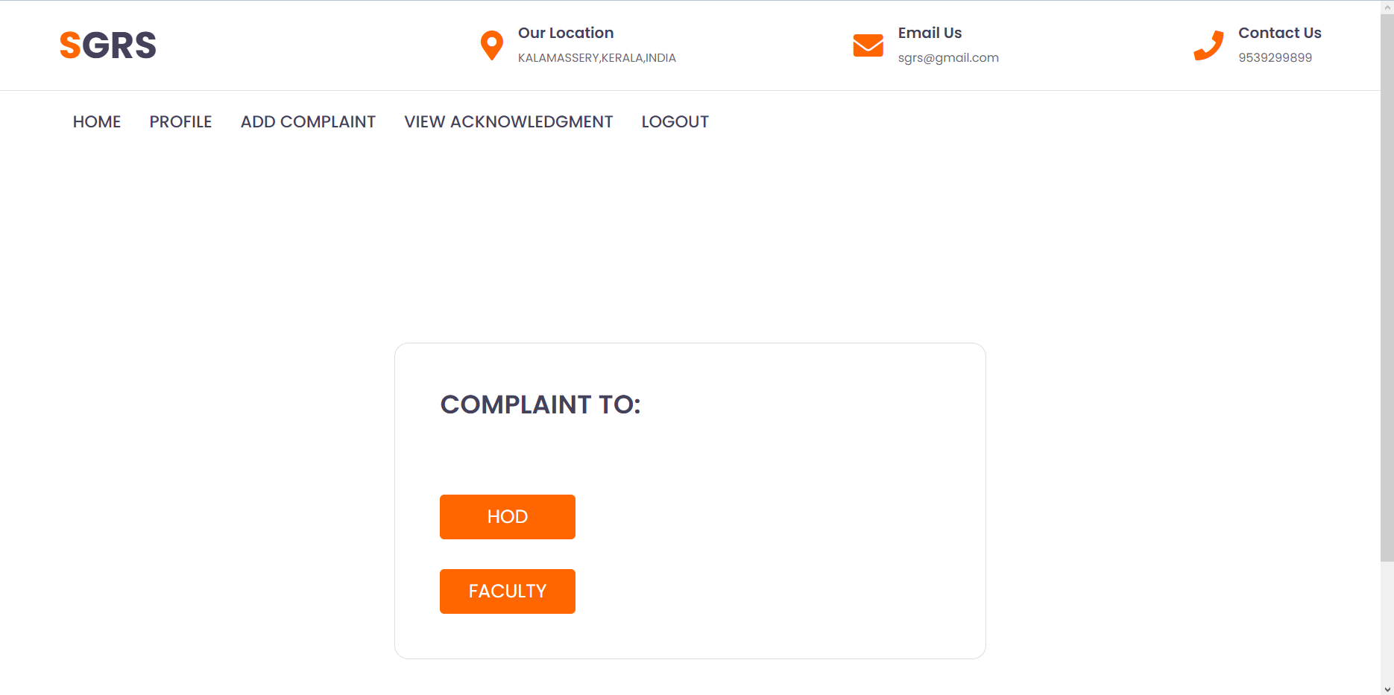
Page: 30

Slide 31
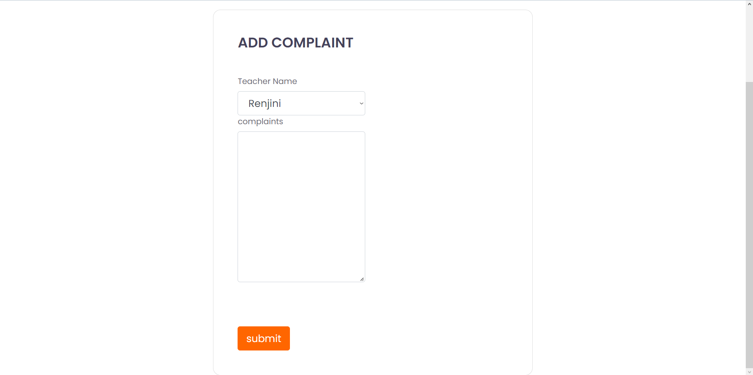
Page: 31

Slide 32
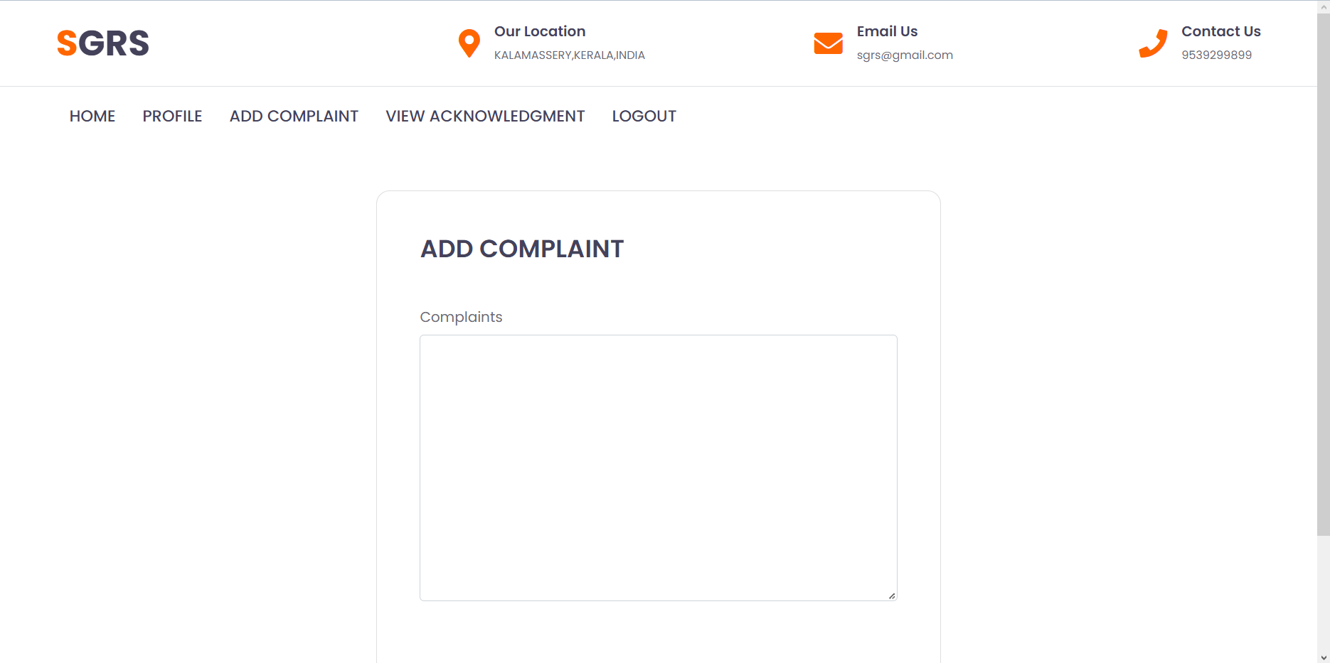
Page: 32

Slide 33
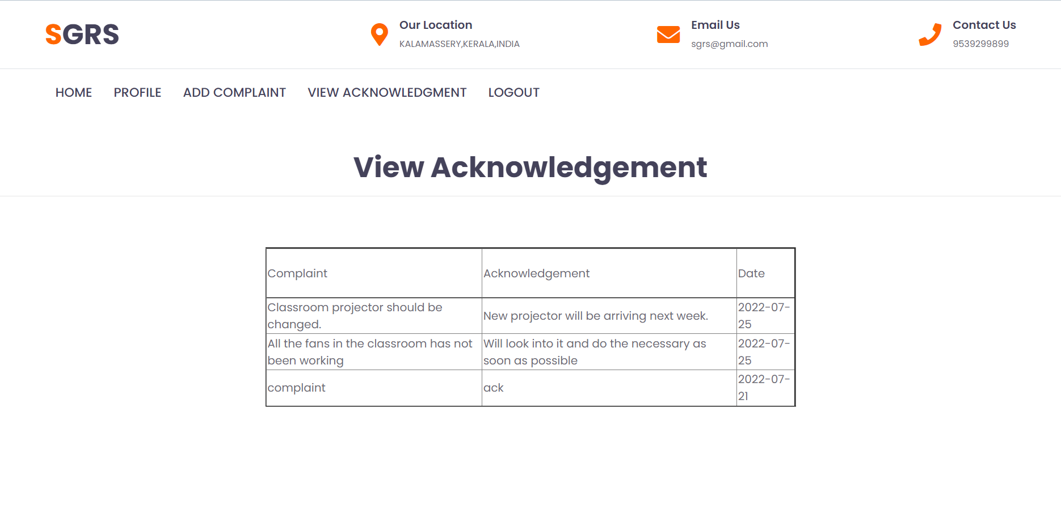
Page: 33

Slide 34
FACULTY
Page: 34

Slide 35

Page: 35

Slide 36
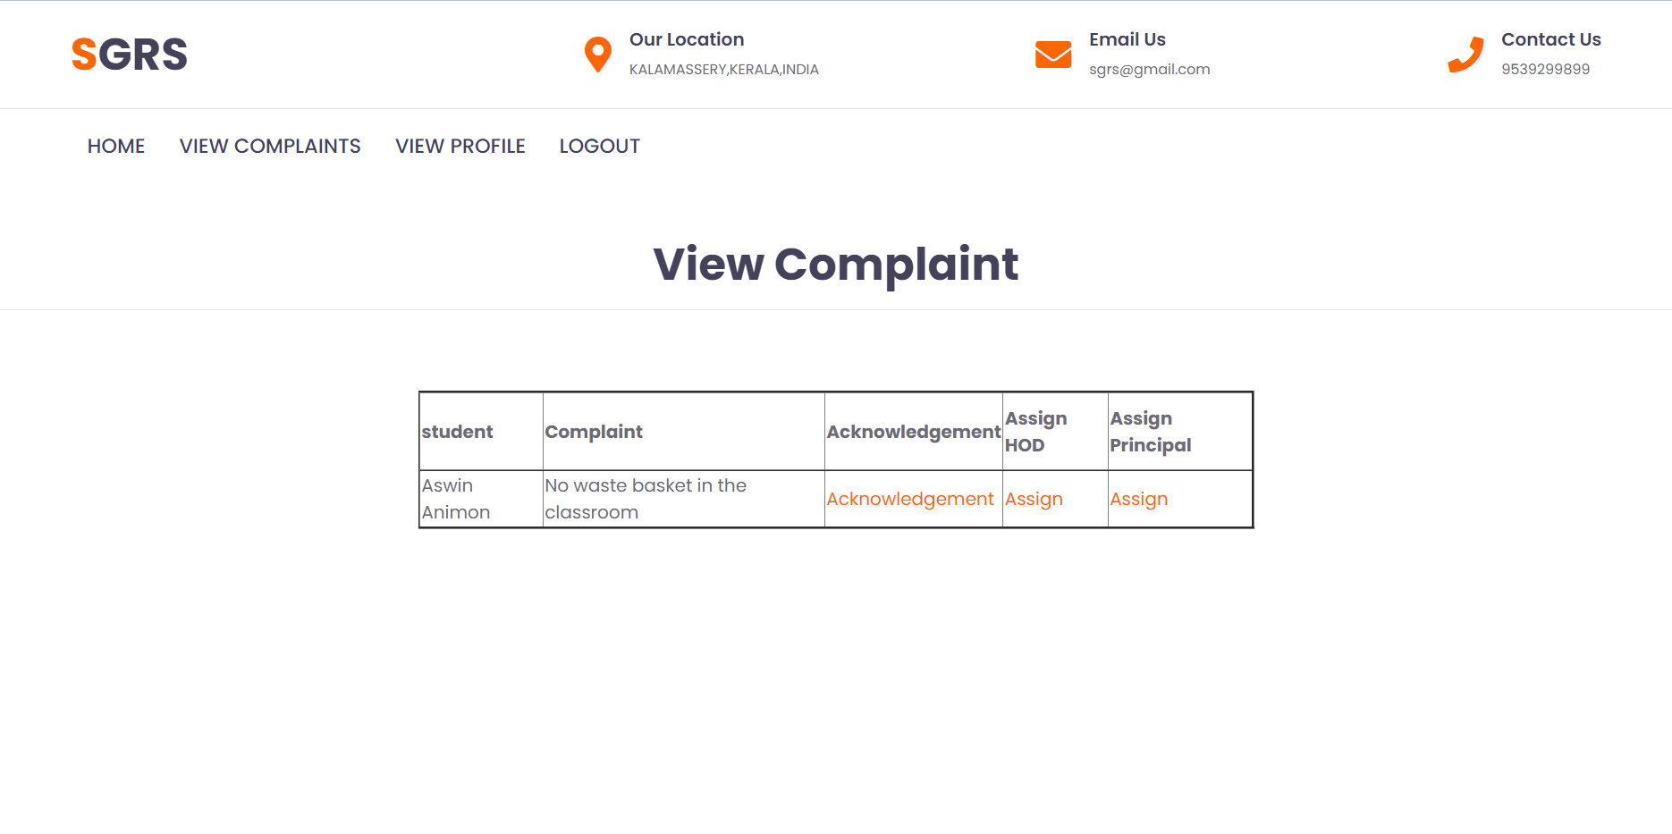
Page: 36

Slide 37
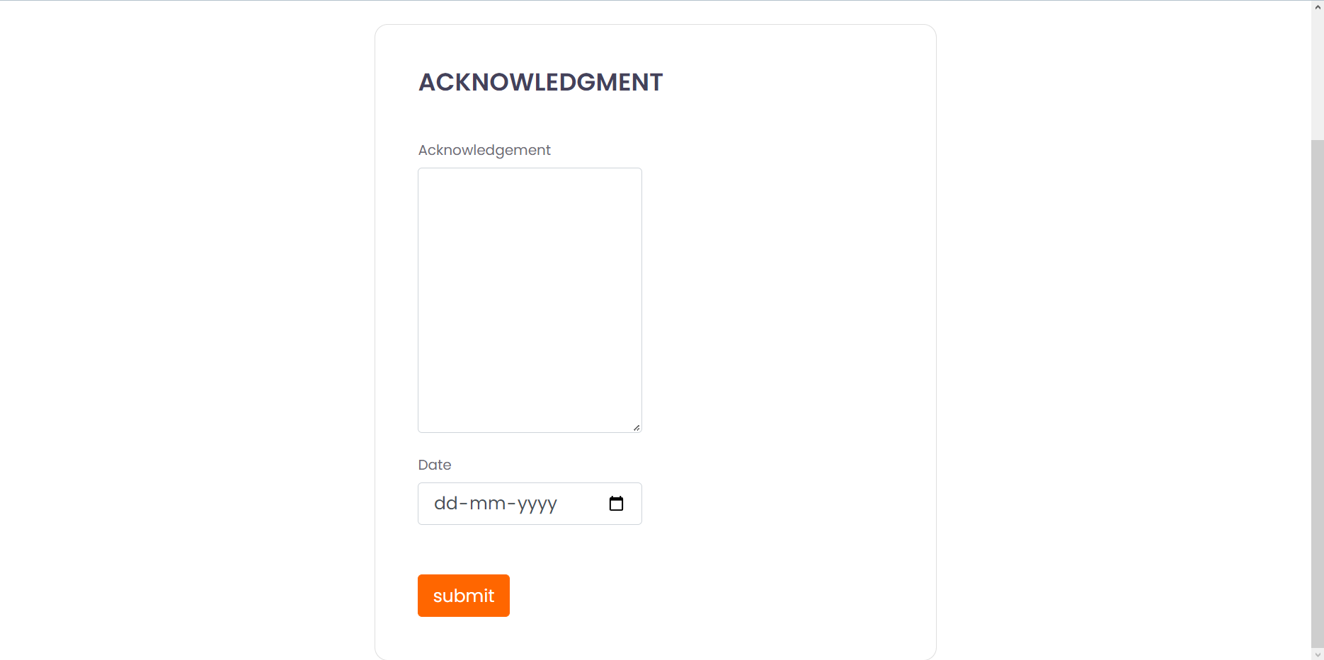
Page: 37

Slide 38
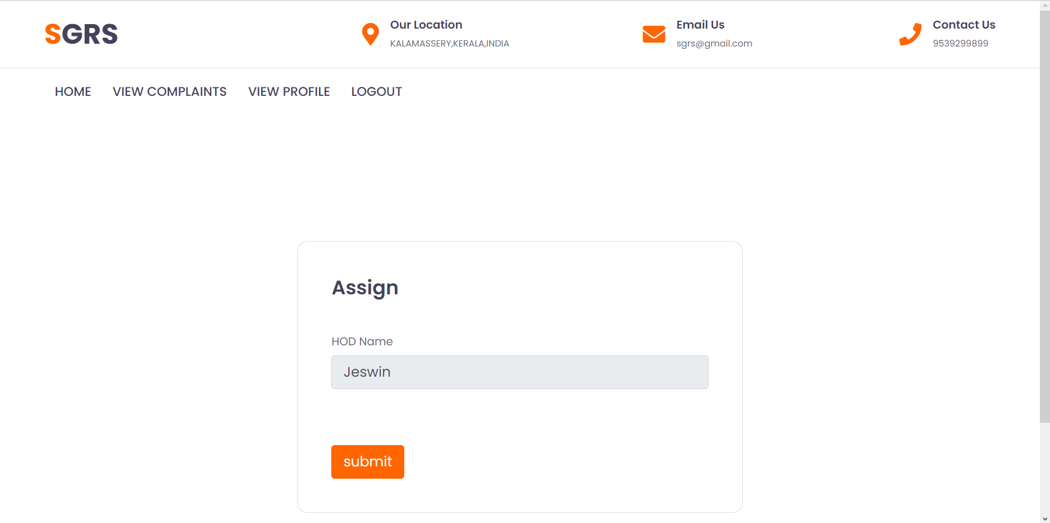
Page: 38

Slide 39
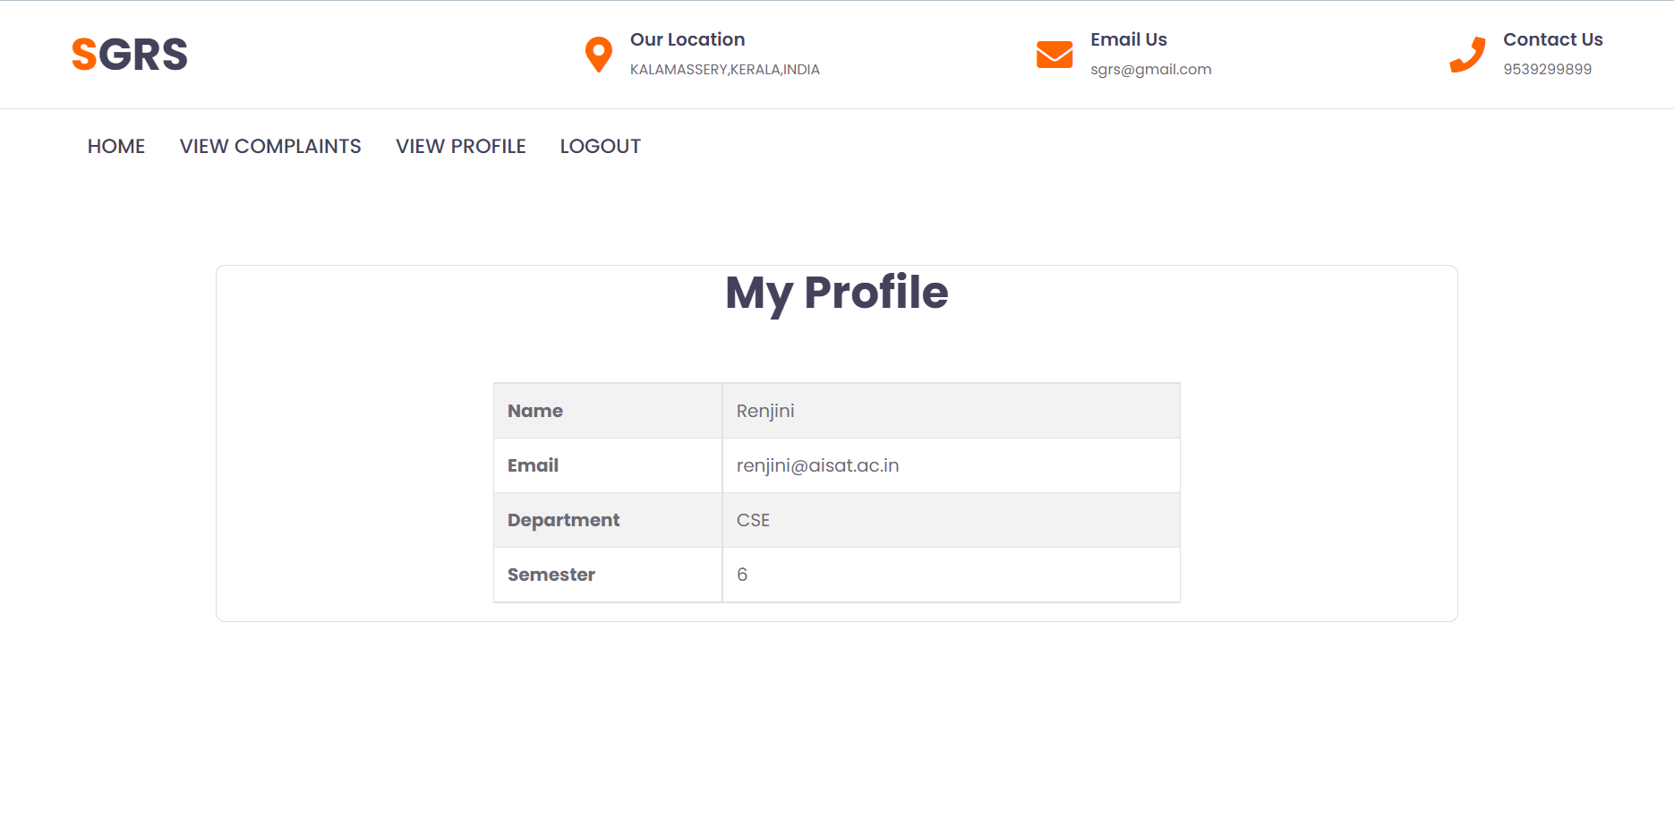
Page: 39

Slide 40
HOD
Page: 40

Slide 41
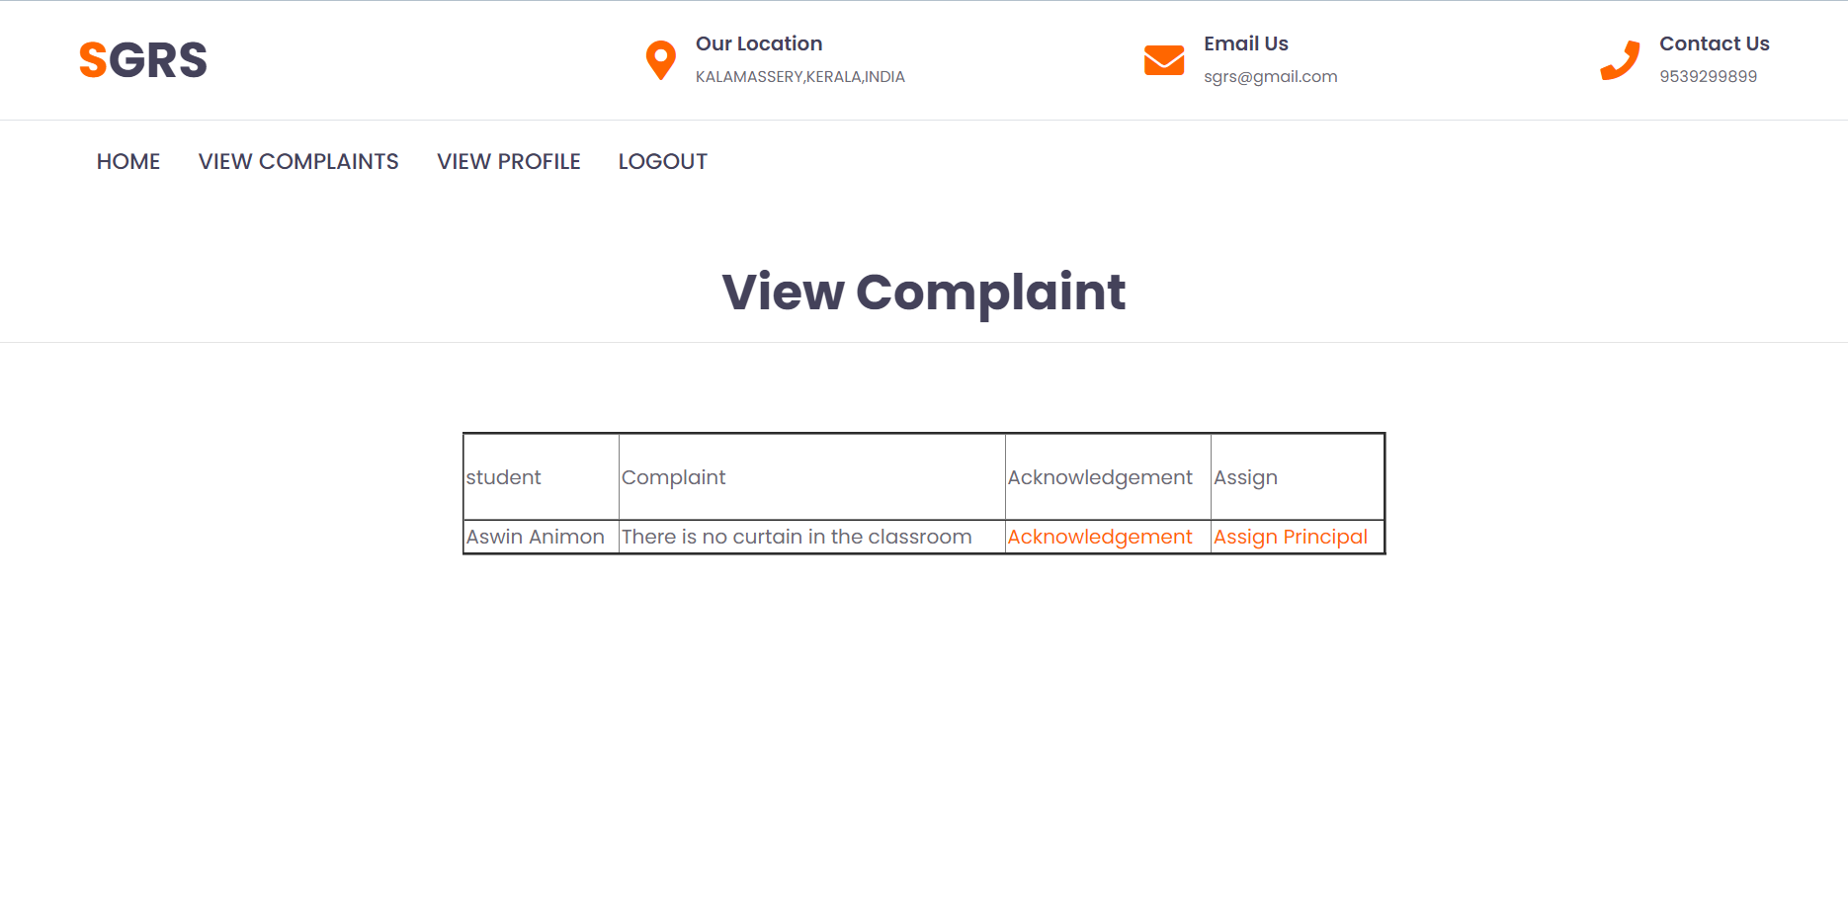
Page: 41

Slide 42

Page: 42

Slide 43
PRINCIPAL
Page: 43

Slide 44
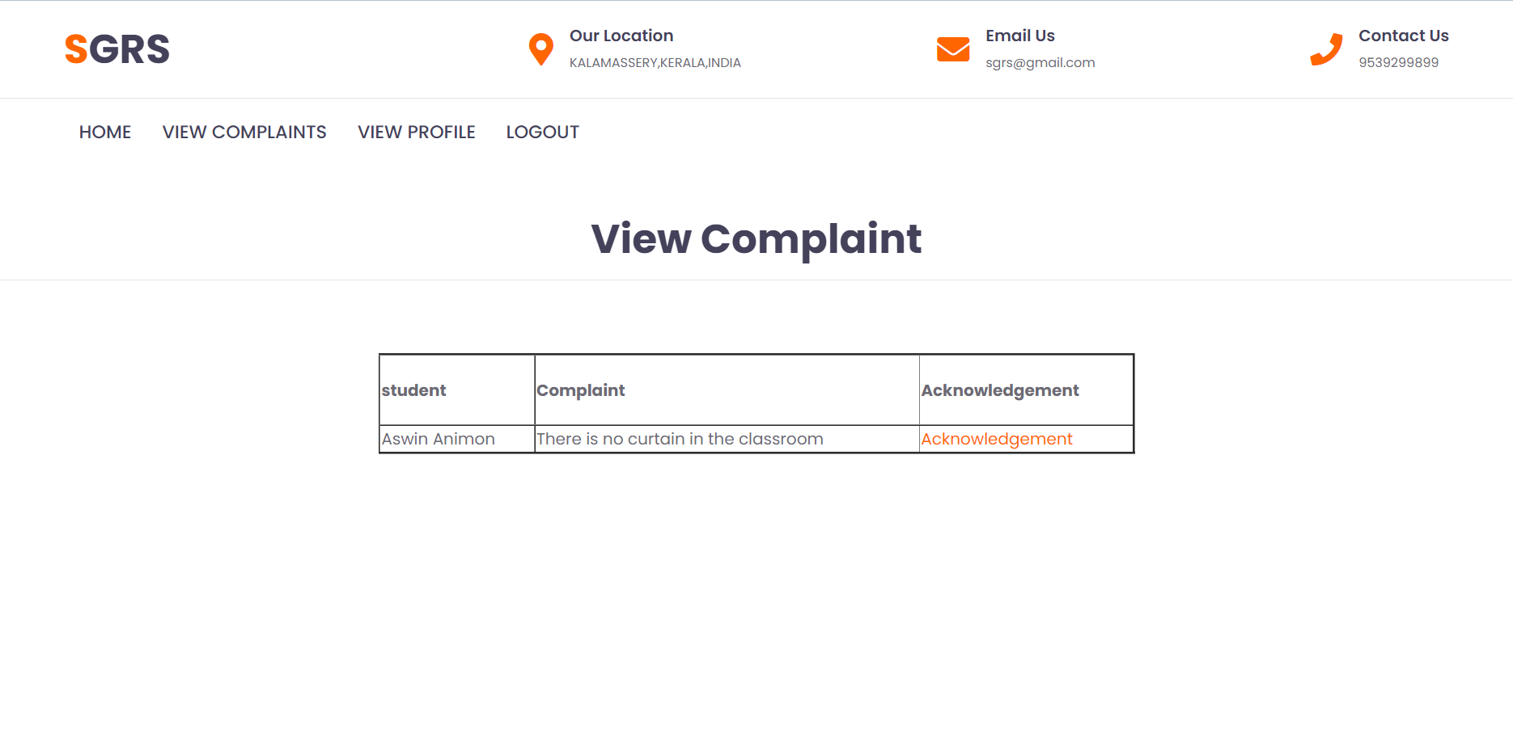
Page: 44

Slide 45
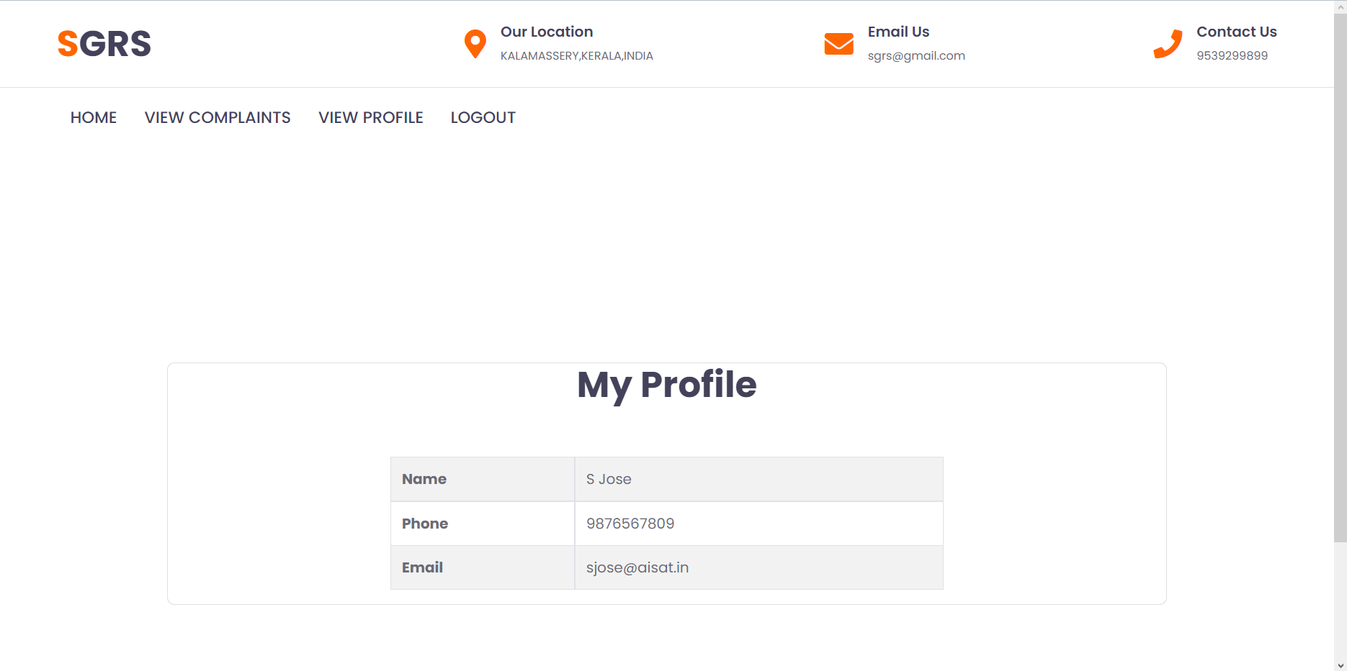
Page: 45

Slide 46
DATABASE
Page: 46
SCREENSHOTS

Slide 47
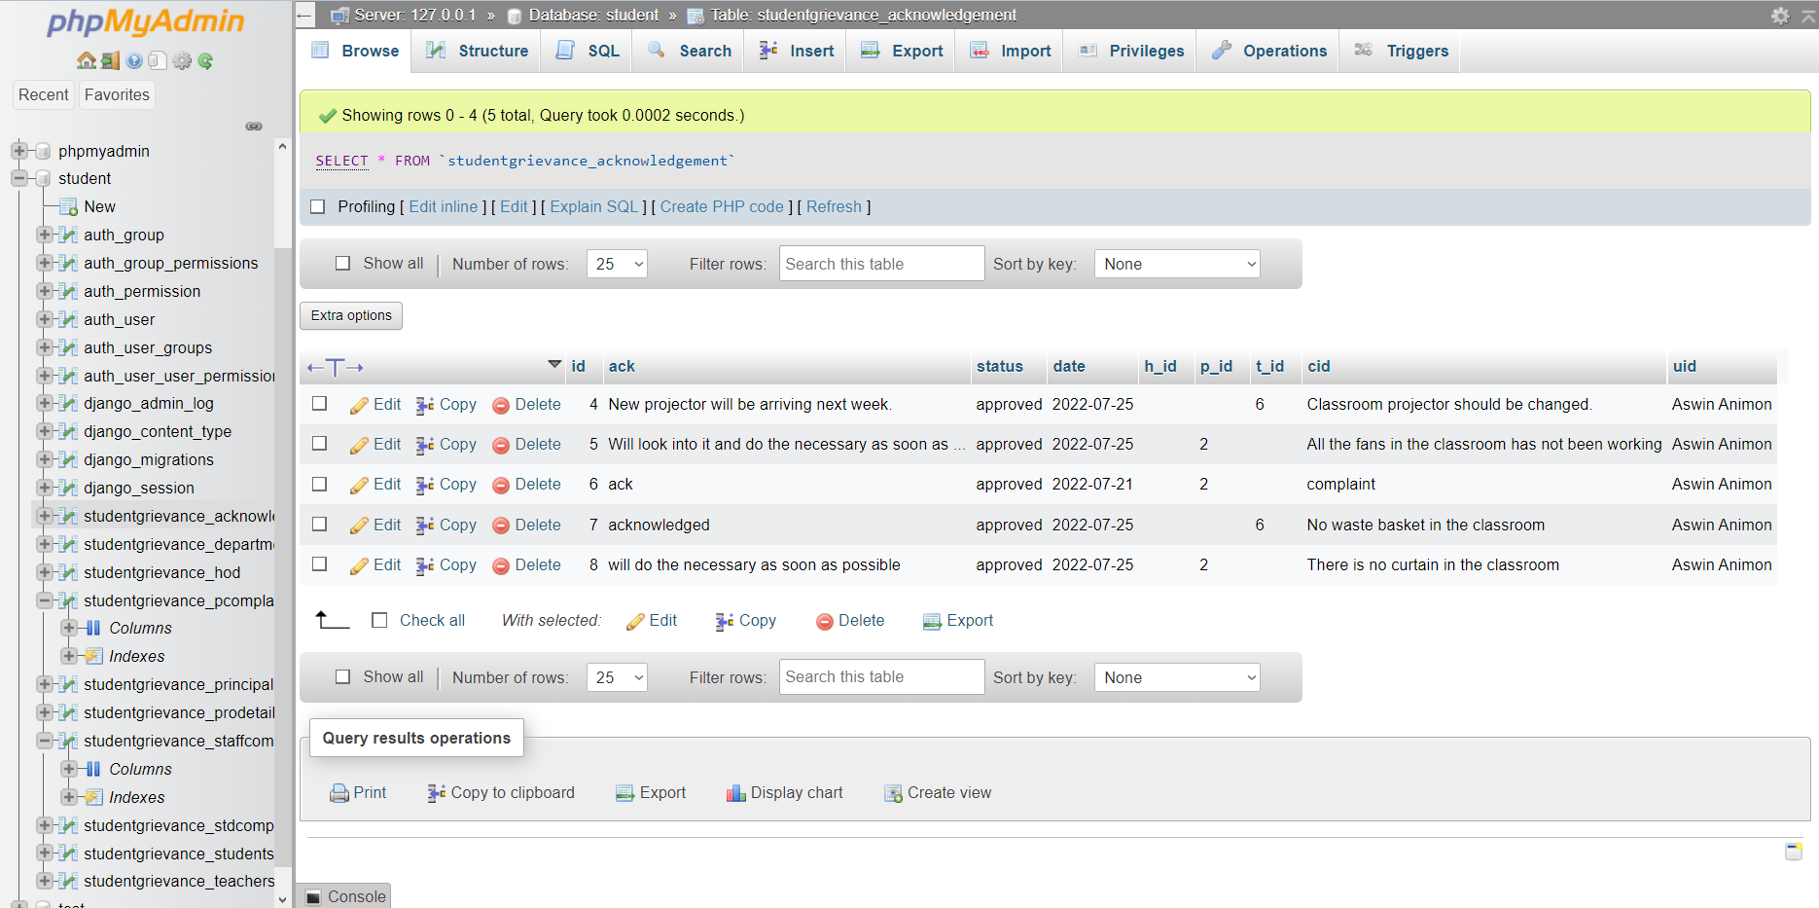
Page: 47

Slide 48
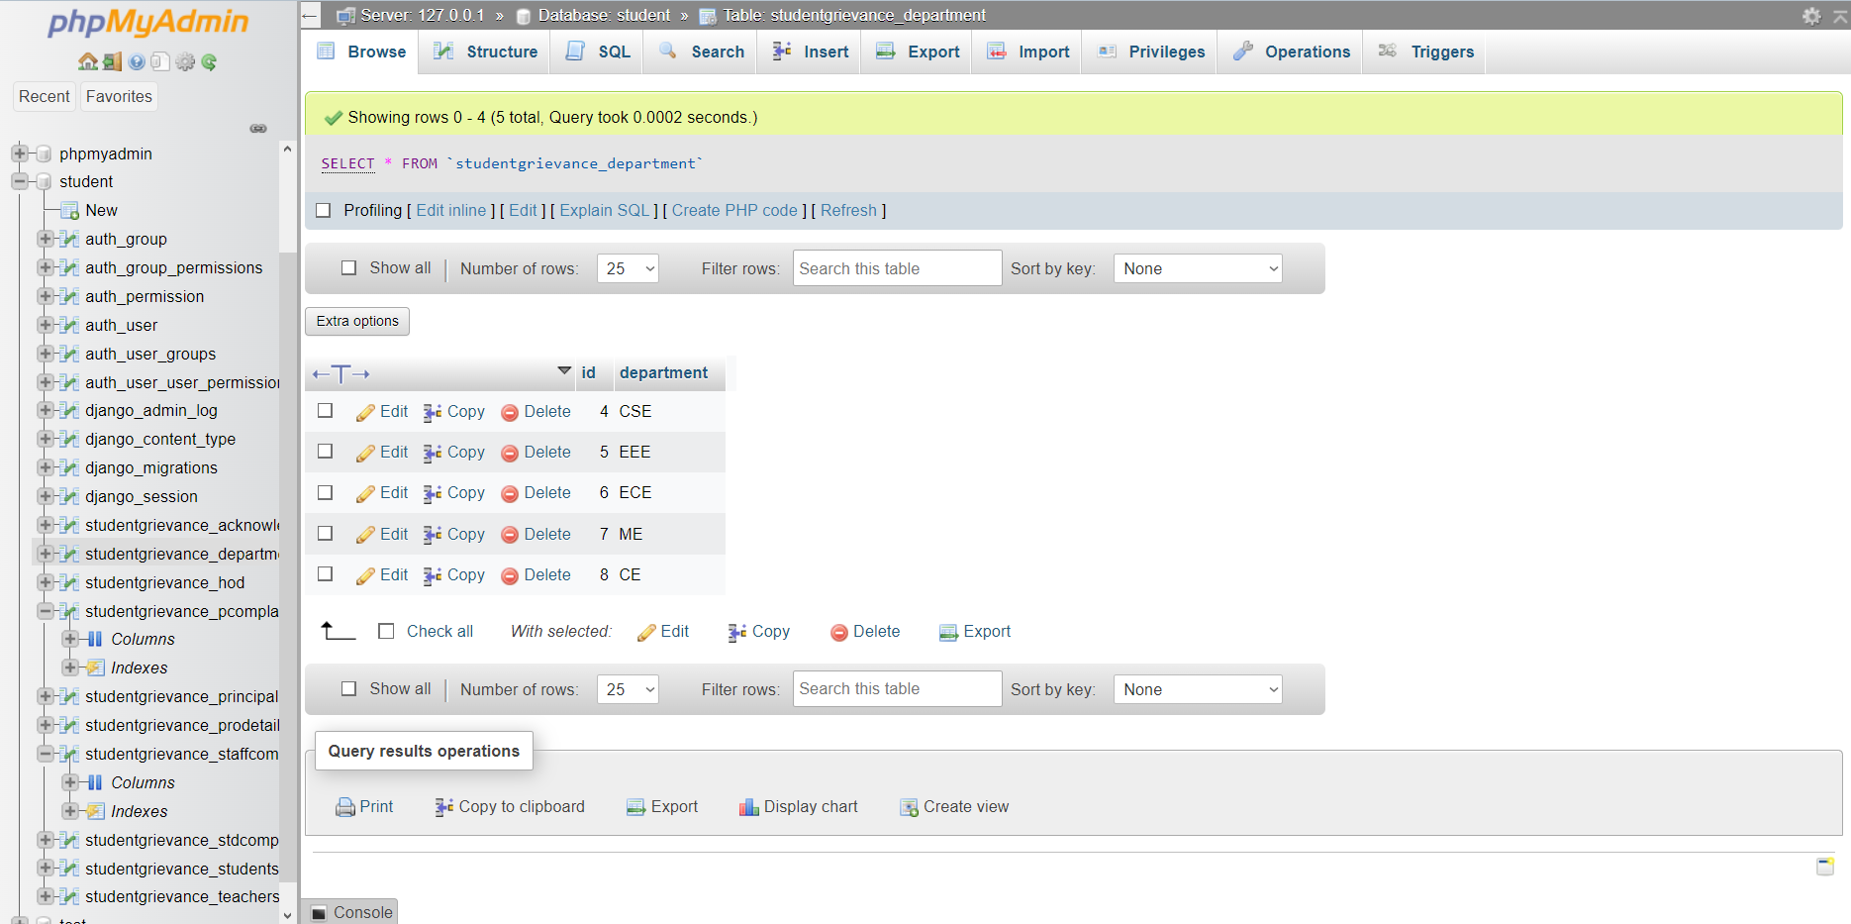
Page: 48

Slide 49
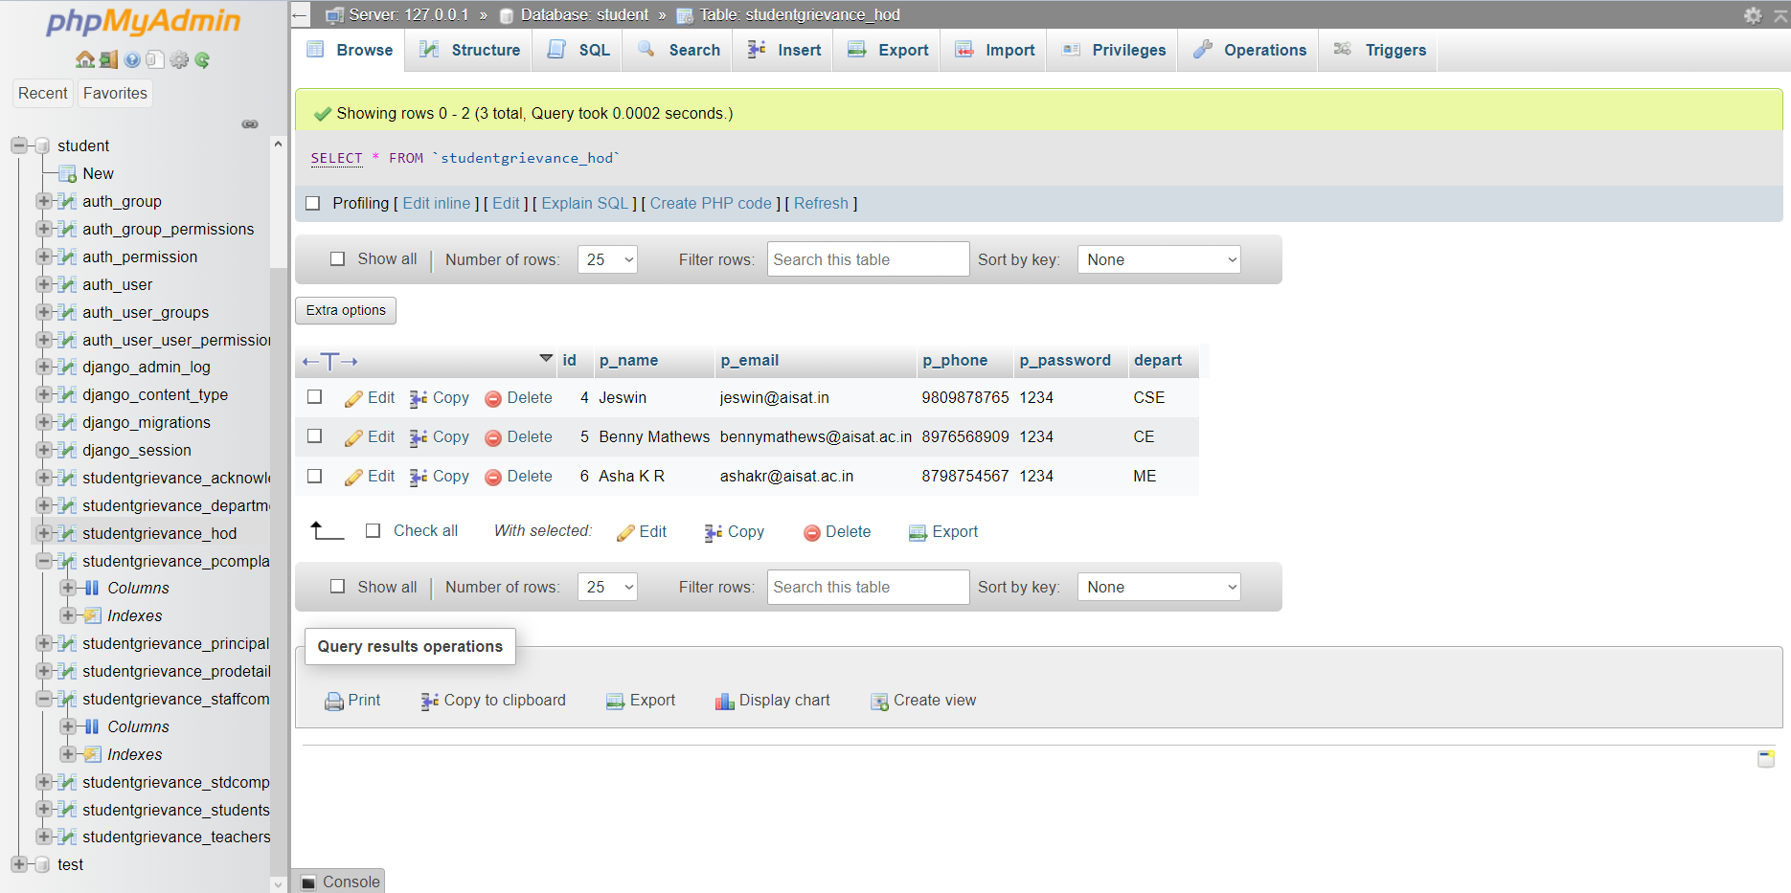
Page: 49

Slide 50
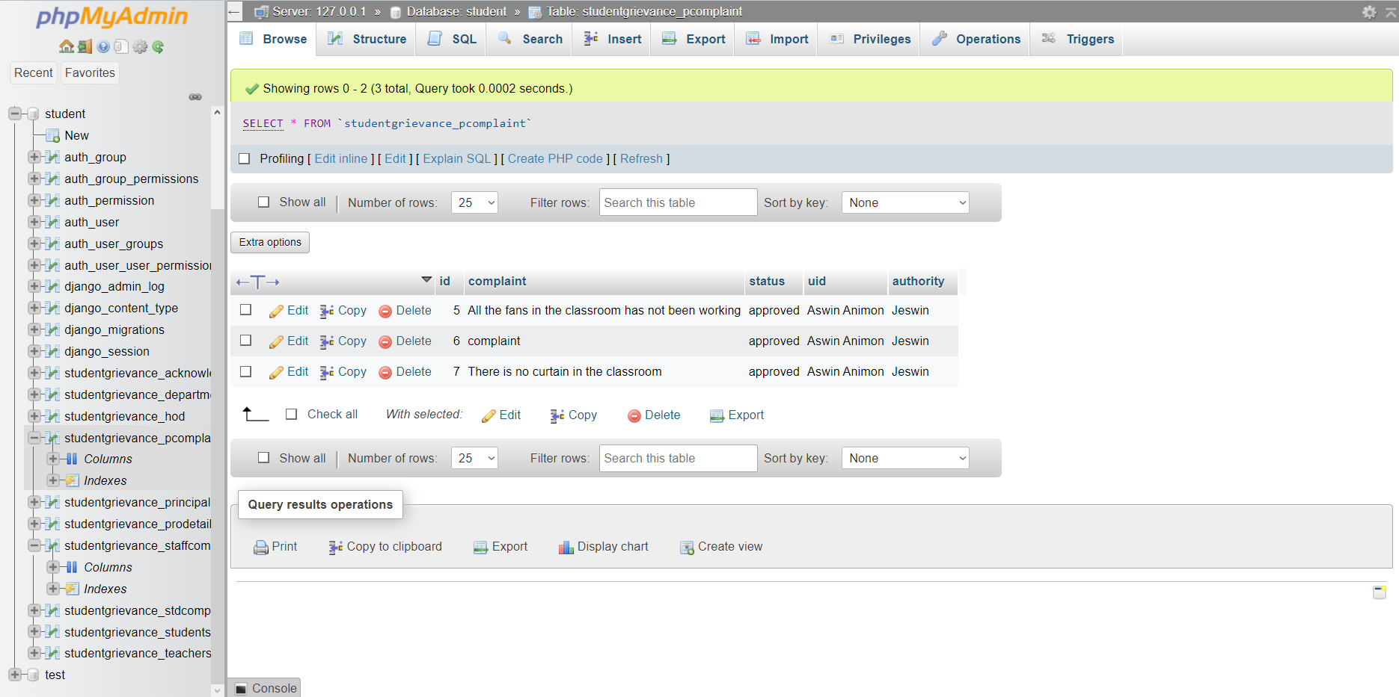
Page: 50

Slide 51
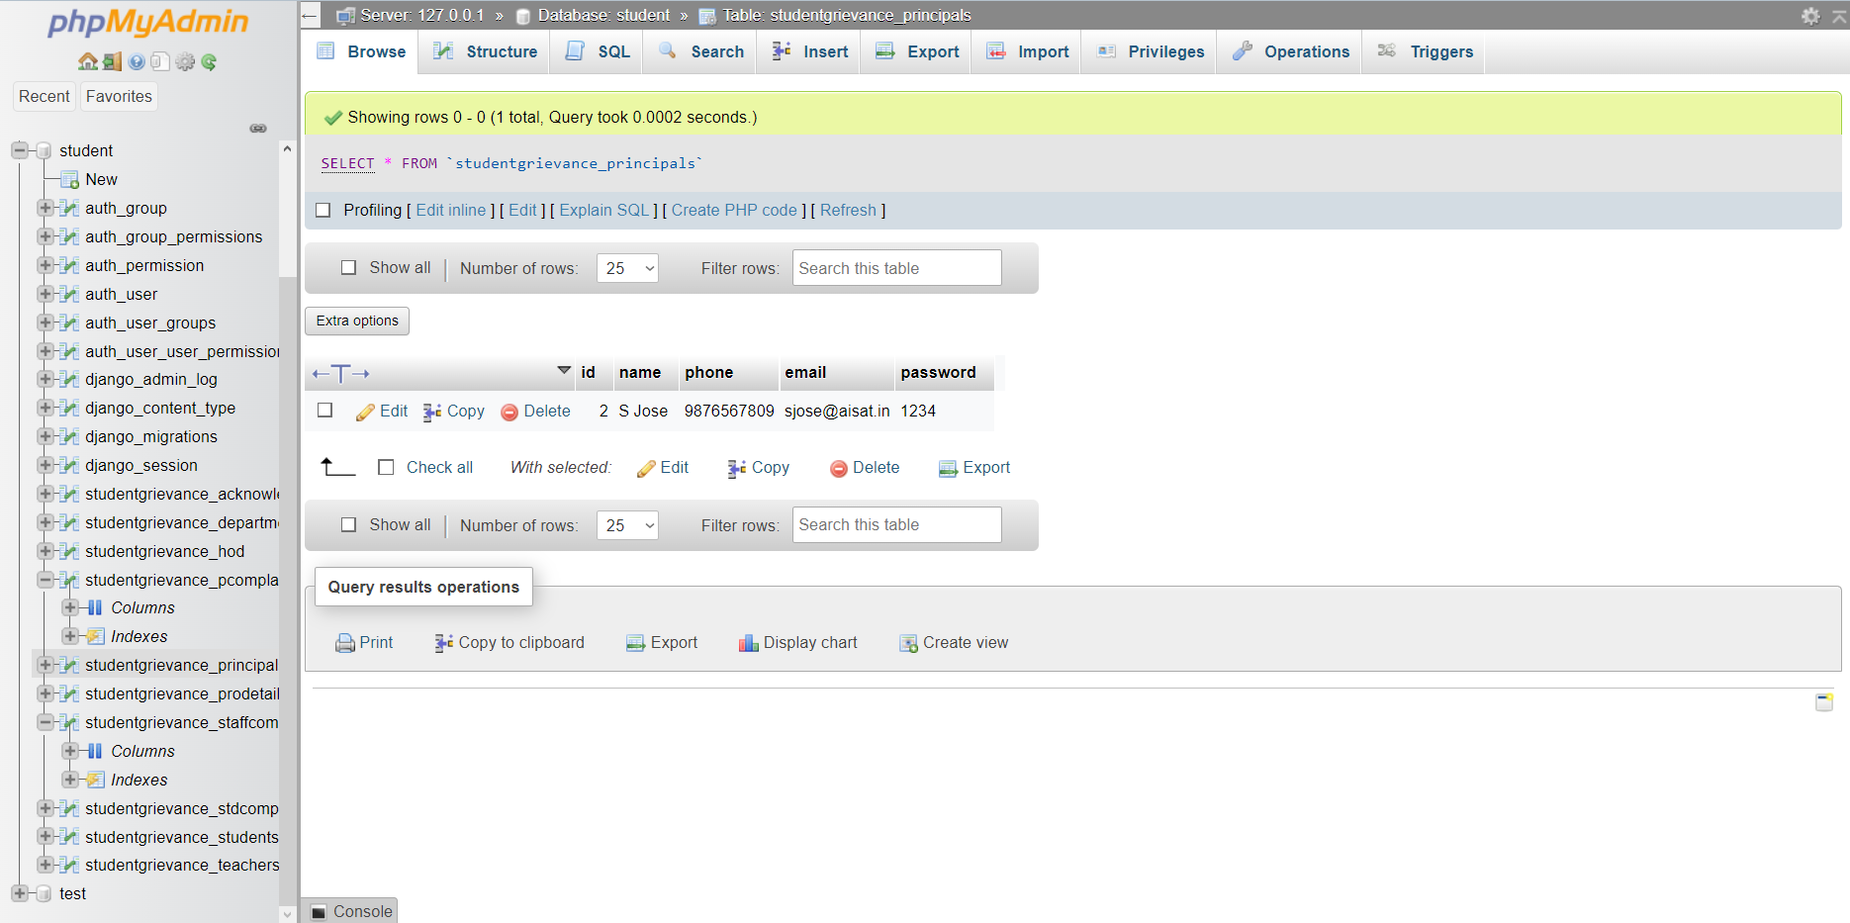
Page: 51

Slide 52
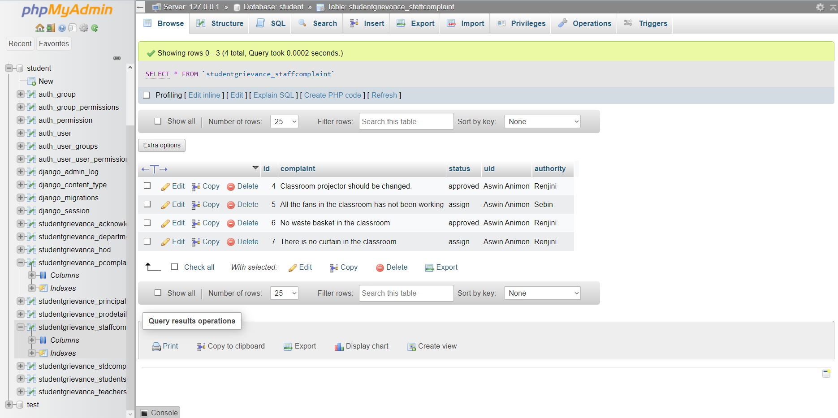
Page: 52

Slide 53
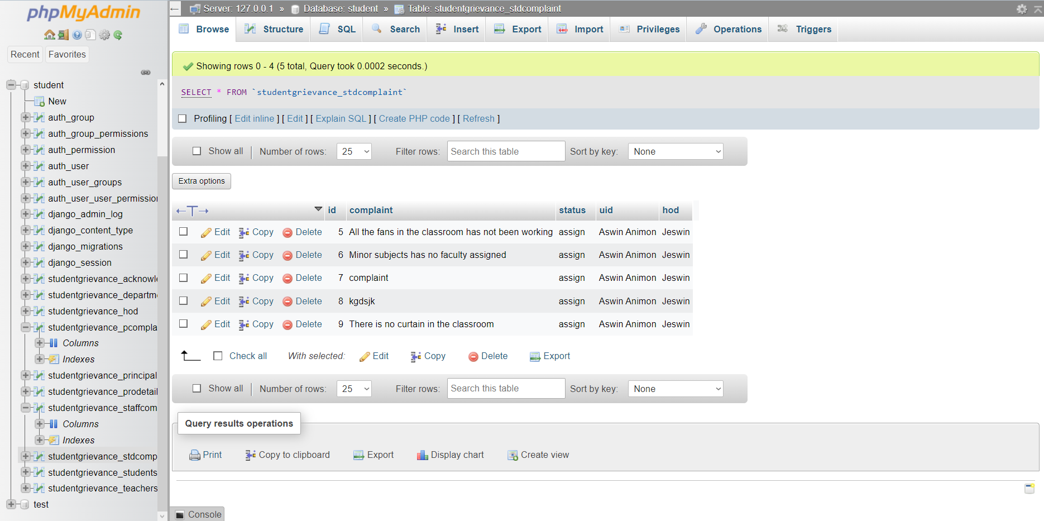
Page: 53

Slide 54
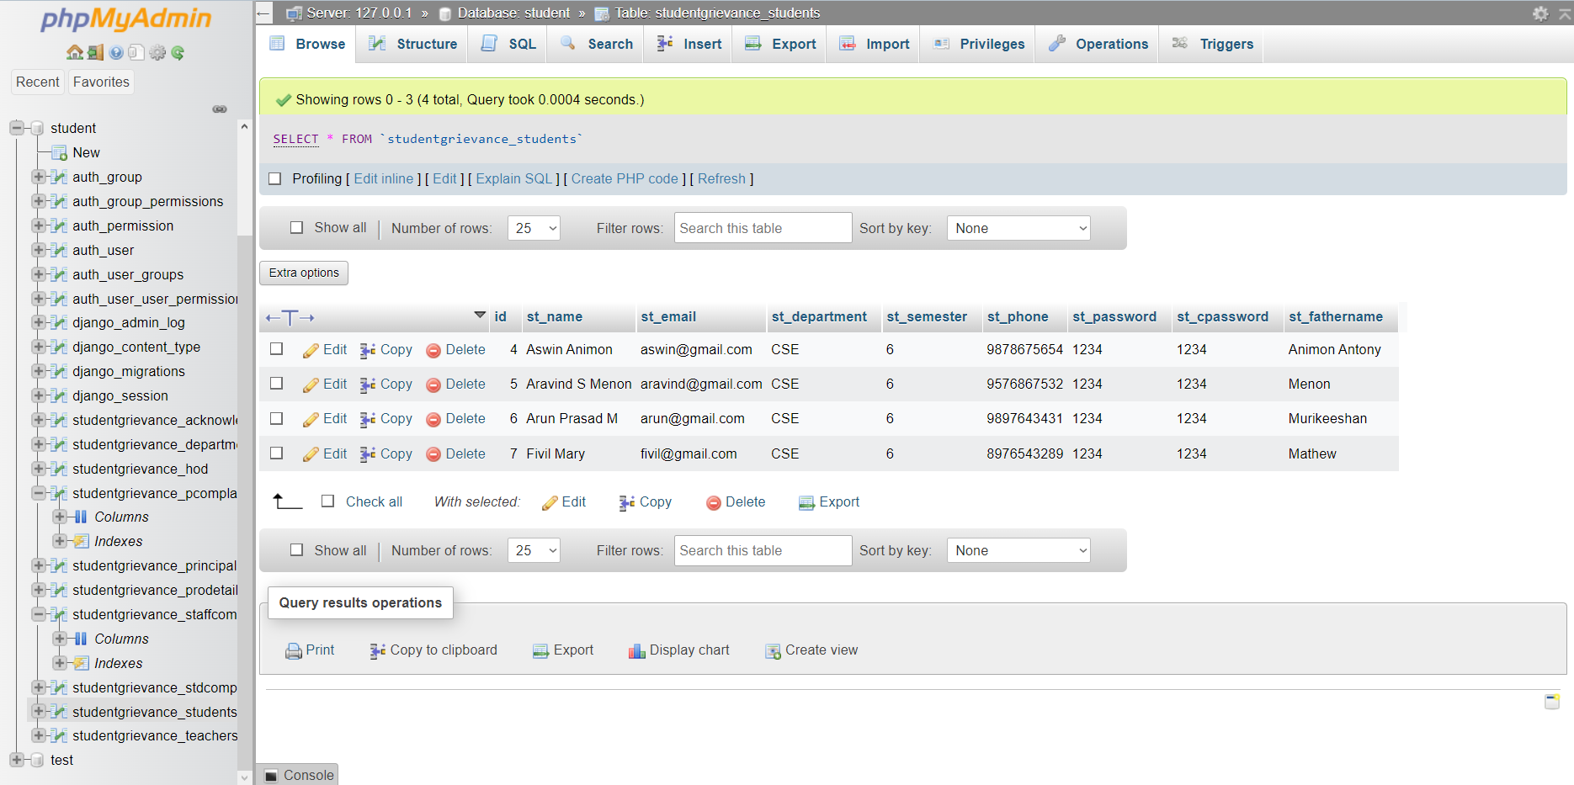
Page: 54

Slide 55
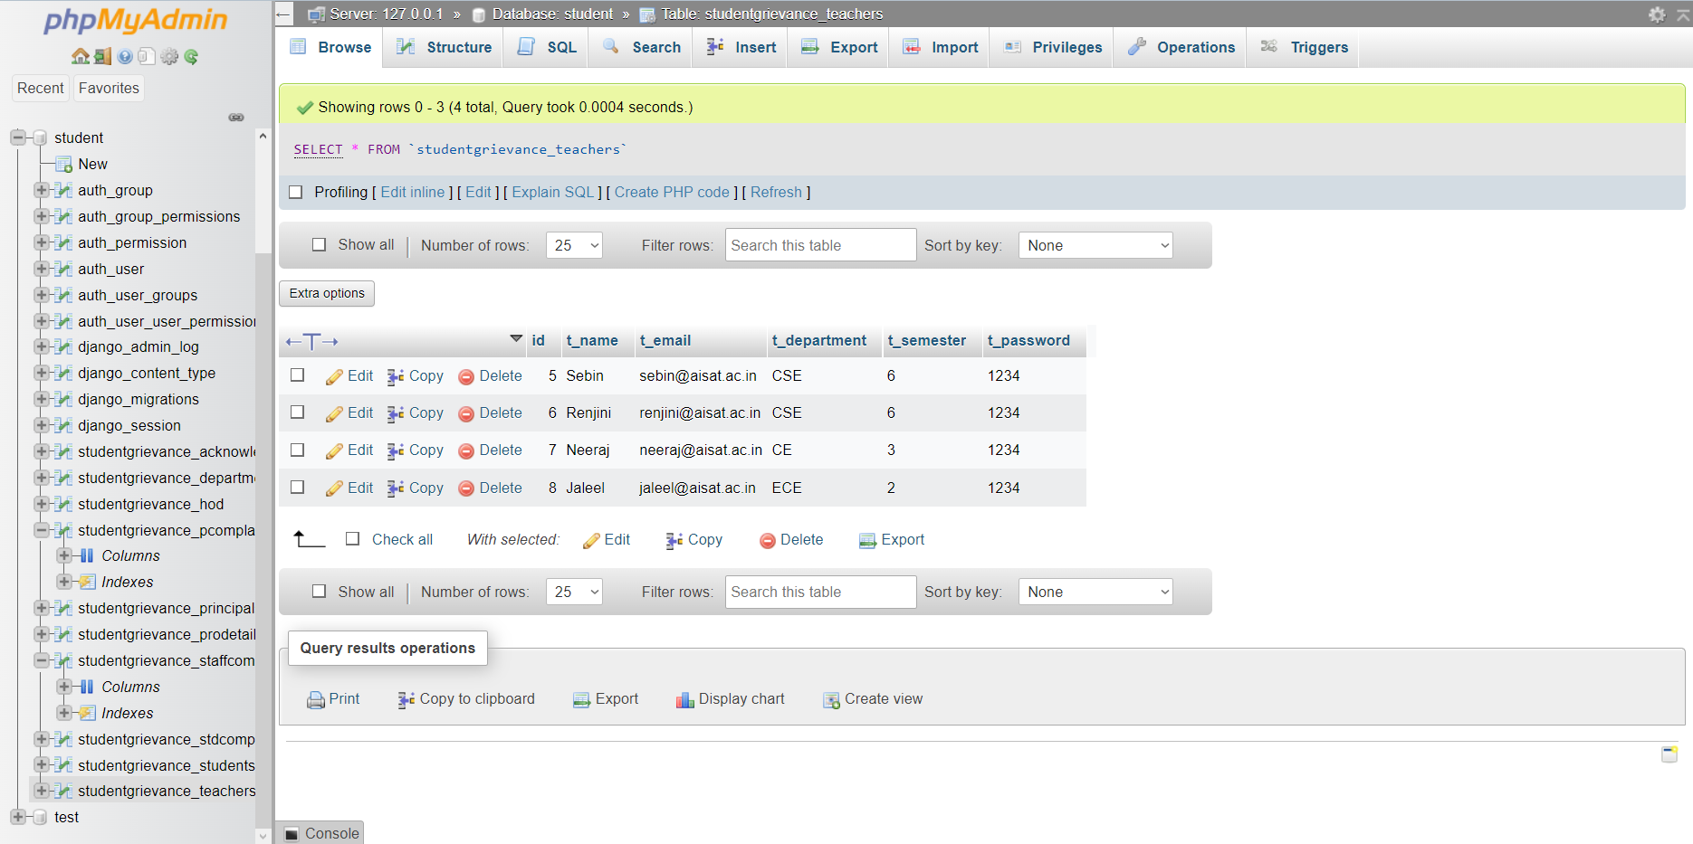
Page: 55

Slide 56
Page: 56
THANK YOU

